Slide 1
Mr. Clutter
Villegas Middle School
Black History Month
February 2007

Slide 2
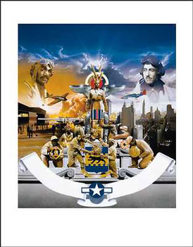
EVENTS THAT CHANGED
BLACK AMERICA
1. MARCH 7, 1942
First Black cadets graduate from flying school at Tuskegee, Alabama. In June 1943, the first squadron of Black aviators, the 99th Pursuit Squadron, flew its first combat mission.
2. NOVEMBER 3, 1942
William L. Dawson is elected to Congress from Chicago. On August 1, 1944, Adam Clayton Powell, Jr., of Harlem became the first Black Congressman from the East.

Slide 3
EVENTS THAT CHANGED
BLACK AMERICA
3. APRIL 3, 1944
The Supreme Court rules in Smith v. Allwright that “White primaries” could not exclude Black voters.
4. MAY 8, 1945
Germany surrenders on V-E Day, Japan surrendered on September 2, V-J Day, ending World War II. A total of 1,154,720 Blacks were inducted into the Armed Services. Many returned to America and attended college with GI Bill of Rights benefits.

Slide 4
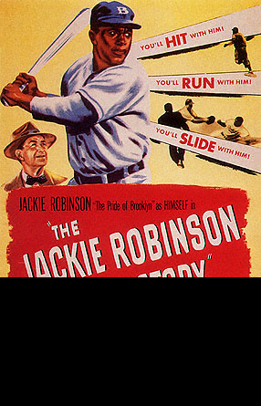
EVENTS THAT CHANGED
BLACK AMERICA
5. OCTOBER 23, 1945
Brooklyn Dodgers who moved to Los Angeles in 1958, sign Jackie Robinson {Died 10-24-72} and send him to their Montreal farm team. On April 15, 1947, Robinson made his debut at Ebbetts Field and became the first Black in the Major Leagues in modern times.

Slide 5
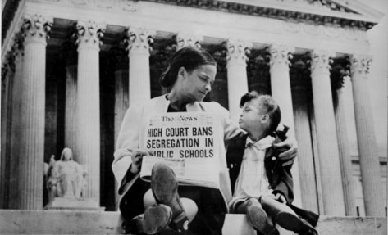
EVENTS THAT CHANGED
BLACK AMERICA
6. MARCH 21, 1946
Kenny Washington signs with the Los Angeles Rams and becomes the first Black player in professional football in 13 years. Three other Blacks: Woody Strode of the Rams; Ben Willis and Marion Motley of the Cleveland Browns -- signed in the same year.
7. MAY 17, 1954
In a unanimous decision, the Supreme Court outlaws segregation in the public school system. Landmark Brown v. Board of Education Topeka decision sounded death knell for legal segregation in the United States.

Slide 6
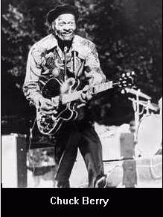
EVENTS THAT CHANGED
BLACK AMERICA
8. MAY 10, 1955
Chuck Berry records “Maybelline,” which played major role in development of rock ‘n’ roll. Berry and other Black stars, notably Muddy Waters and Little Richard, were the major musical influences on the Beatles and other White groups.

Slide 7
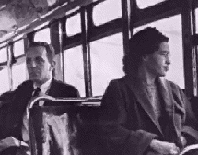
EVENTS THAT CHANGED
BLACK AMERICA
9. DECEMBER 5, 1955
Historic bus boycott begins in Montgomery, Alabama. Rosa Parks {Died 10-25-05 at the age of 92} sparked the boycott when she refused to give her bus seat to a White man. The Rev. Martin Luther King, Jr. was elected president of the boycott organization.

Slide 8
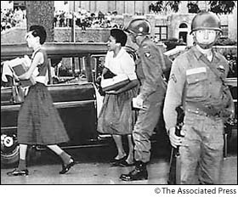
EVENTS THAT CHANGED
BLACK AMERICA
10. SEPTEMBER 25, 1957
Nine Little Rock, Arkansas, schoolchildren are escorted to Central High School by federal troops, ending efforts to thwart court-ordered integration.

Slide 9
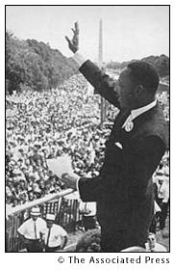
EVENTS THAT CHANGED
BLACK AMERICA
11. DECEMBER 17, 1959
The founding of Motown Records {Barry Gordon} help change the understanding, marketing, and promotion of Black popular music.
12. AUGUST 28, 1963
25,000 people participate in the March
on Washington, the biggest civil rights
demonstration ever. This is where
Dr. Martin Luther King, Jr., delivered
his famous speech “I Have a Dream.”

Slide 10
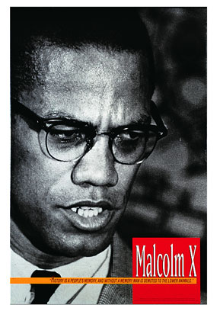
EVENTS THAT CHANGED
BLACK AMERICA
13. FEBRUARY 21, 1965
Malcolm X {Malcolm Little} charismatic Black nationalist leader, is assassinated at the Audubon Ballroom in Harlem. Three Blacks were later convicted and sentenced to life imprisonment.

Slide 11
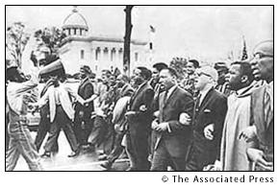
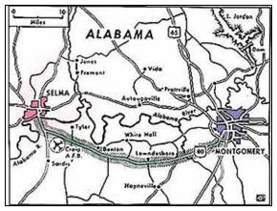
EVENTS THAT CHANGED
BLACK AMERICA
14. MARCH 21, 1965
Thousands of marchers, led by Dr. Martin Luther King, Jr. and protected by federal troops, complete the first leg of the Selma-to Montgomery march.

Slide 12
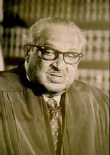
EVENTS THAT CHANGED
BLACK AMERICA
15. AUGUST 11, 1965
An insurrection starts in the Watts section of Los Angeles and rages for six days. The Watts insurrection was the first in a wave of major disturbances that forced a national reappraisal of racism in America.
16. OCTOBER 2, 1967
Thurgood Marshall {1908 – 1993] becomes the first Black member of the U.S. Supreme Court.

Slide 13
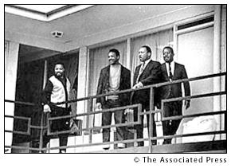
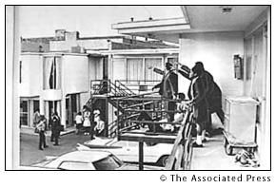
EVENTS THAT CHANGED
BLACK AMERICA
17. APRIL 4, 1968
Martin Luther King, Jr. is assassinated by a James Earl Ray in Memphis. The assassination triggered a national crisis with rioting in more than 100 cities and calls for racial renewal and repentance. President Johnson declared a day of mourning. Note: James Earl Ray died April 23, 1998.

Slide 14
EVENTS THAT CHANGED
BLACK AMERICA
18. JANUARY 23-30, 1977
The ABC-TV dramatization of Alex Haley’s Roots becomes the highest-rated drama in TV history and sparks a national “roots” craze.

Slide 15
EVENTS THAT CHANGED
BLACK AMERICA
19. NOVEMBER 2, 1983
President Ronald Reagan signs a bill designating the third Monday in January of each year as a federal holiday in honor of Dr. Martin Luther King, Jr. Millions celebrated the first holiday on January 20, 1986.

Slide 16
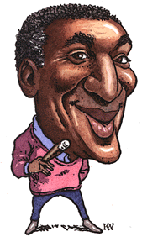
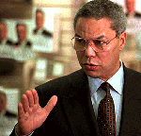
EVENTS THAT CHANGED
BLACK AMERICA
20. SEPTEMBER 20, 1984
The Cosby Show premieres on NBC-TV and changes the image of African-American and the viewing habits of White Americans.
21. SEPTEMBER 21, 1989
General Colin L. Powell is confirmed by the Senate as the Chairman of the Joint Chiefs of Staff. He was the highest ranking African-American officer in the U.S. History.

Slide 17
EVENTS THAT CHANGED
BLACK AMERICA
22. JUNE 27, 1991
Supreme Court Justice Thurgood Marshall announces his retirement and decries the increasingly conservative direction of the Court. On July 1, President Bush nominated Clarence Thomas, a conservative Black on the U.S. District of Columbia Court of Appeals to fill the vacant seat. He was confirmed by a narrow 52 to 48 margin after Attorney Anita Hill, accused him of sexual harassment.

Slide 18
This powerpoint was kindly donated to www.worldofteaching.com
http://www.worldofteaching.com is home to over a thousand powerpoints submitted by teachers. This is a completely free site and requires no registration. Please visit and I hope it will help in your teaching.

